Slide 1
Introduction to Data Analytics
Lecture 3
Professor Pottenger

Slide 2
Algorithms:
The Basic Methods

Slide 3
Simplicity first
Simple algorithms often work surprisingly well
Many different kinds of simple structures exist:
One attribute might do all the work
All attributes might contribute independently with equal importance
A linear combination might be sufficient
An instance-based representation might work best
Simple logical structures might be appropriate
Success of method depends on the domain!
Notes:
What’s the simplest possible algorithm? One that doesn’t use any attributes at all… think about predicting the action to take at a stop sign. What is the label that occurs most frequently in the training data? Now, how about a traffic signal (red, yellow, green)?

Slide 4
Inferring rudimentary rules
1R: learns a 1-level decision tree
In other words, generates a set of rules that all test on one particular attribute
Basic version (assuming nominal attributes)
One branch for each of the attribute’s values
Each leaf is assigned with most frequent class
Error rate: proportion of instances that don’t belong to the majority class of their corresponding branch
Choose attribute with lowest error rate

Slide 5
Evaluating the weather attributes
Outlook | Temp. | Humidity | Windy | Play
Sunny | Hot | High | False | No
Sunny | Hot | High | True | No
Overcast | Hot | High | False | Yes
Rainy | Mild | High | False | Yes
Rainy | Cool | Normal | False | Yes
Rainy | Cool | Normal | True | No
Overcast | Cool | Normal | True | Yes
Sunny | Mild | High | False | No
Sunny | Cool | Normal | False | Yes
Rainy | Mild | Normal | False | Yes
Sunny | Mild | Normal | True | Yes
Overcast | Mild | High | True | Yes
Overcast | Hot | Normal | False | Yes
Rainy | Mild | High | True | No
Attribute | Rules | Errors | Total errors
Outlook | Sunny → No | 2/5 | 4/14
 | Overcast → Yes | 0/4
 | Rainy → Yes | 2/5
Temperature | Hot → No* | 2/4 | 5/14
 | Mild → Yes | 2/6
 | Cool → Yes | 1/4
Humidity | High → No | 3/7 | 4/14
 | Normal → Yes | 1/7
Windy | False → Yes | 2/8 | 5/14
 | True → No* | 3/6

Slide 6
Pseudo-code for 1R
Note: “missing” is always treated as a separate attribute value
For each attribute, For each value of the attribute, make a rule as follows: count how often each class appears find the most frequent class make the rule assign that class to this attribute-value Calculate the error rate of the rules Choose the rules with the smallest error rate

Slide 7
Dealing with numeric attributes
Numeric attributes are discretized: the range of the attribute is divided into a set of intervals
Instances are sorted according to attribute’s values
Breakpoints are placed where the (majority) class changes (so that the total error is minimized)
Example: temperature from weather data
64 65 68 69 70 71 72 72 75 75 80 81 83 85
Yes | No | Yes Yes Yes | No No | Yes Yes Yes | No | Yes Yes | No

Slide 8
Discretization of Numeric Attributes
Discretization procedure is very sensitive to noise
A single instance with an incorrect class label will most likely result in a separate interval
Simple solution: enforce minimum number of instances in majority class per interval
Weather data example (with minimum set to 3):
65 68 69 70 71 72 72 75 75 80 81 83 85 Yes No Yes Yes Yes | No No Yes Yes Yes | No Yes Yes No

Slide 9
Final Result of Discretization
Final result for for temperature attribute:
Resulting
rule sets (if
temperature
and humidity
discretized):
64 65 68 69 70 71 72 72 75 75 80 81 83 85 Yes No Yes Yes Yes No No Yes Yes Yes | No Yes Yes No
Attribute | Rules | Errors | Total errors
Outlook | Sunny → No | 2/5 | 4/14
 | Overcast → Yes | 0/4
 | Rainy → Yes | 2/5
Temperature | ≤ 77.5 → Yes | 3/10 | 5/14
 | > 77.5 → No* | 2/4
Humidity | ≤ 82.5 → Yes | 1/7 | 3/14
 | > 82.5 and ≤ 95.5 → No | 2/6
 | > 95.5 → Yes | 0/1
Windy | False → Yes | 2/8 | 5/14
 | True → No* | 3/6

Slide 10
Discussion of 1R
1R was described in a paper by Holte (1993)
Contains an experimental evaluation on 16 datasets (using cross-validation so that results were representative of performance on future data)
Minimum number of instances was set to six after some experimentation
1R’s simple rules performed not much worse than much more complex decision trees
Simplicity first pays off!

Slide 11
Statistical modeling
“Opposite” of 1R: use all the attributes
Two assumptions: Attributes are
equally important
statistically independent
This means that knowledge about the value of a particular attribute doesn’t tell us anything about the value of another attribute
Although based on assumptions that are almost never correct, this scheme works well in practice!

Slide 12
Probabilities for the weather data
Outlook |  |  | Temperature |  |  | Humidity |  |  | Windy |  |  | Play
 | Yes | No |  | Yes | No |  | Yes | No |  | Yes | No | Yes | No
Sunny | 2 | 3 | Hot | 2 | 2 | High | 3 | 4 | False | 6 | 2 | 9 | 5
Overcast | 4 | 0 | Mild | 4 | 2 | Normal | 6 | 1 | True | 3 | 3
Rainy | 3 | 2 | Cool | 3 | 1
Sunny | 2/9 | 3/5 | Hot | 2/9 | 2/5 | High | 3/9 | 4/5 | False | 6/9 | 2/5 | 9/14 | 5/14
Overcast | 4/9 | 0/5 | Mild | 4/9 | 2/5 | Normal | 6/9 | 1/5 | True | 3/9 | 3/5
Rainy | 3/9 | 2/5 | Cool | 3/9 | 1/5
A new day:
Likelihood of the two classes For “yes” = 2/9 × 3/9 × 3/9 × 3/9 × 9/14 = 0.0053 For “no” = 3/5 × 1/5 × 4/5 × 3/5 × 5/14 = 0.0206 Conversion into a probability by normalization: P(“yes”) = 0.0053 / (0.0053 + 0.0206) = 0.205 P(“no”) = 0.0206 / (0.0053 + 0.0206) = 0.795
Outlook | Temp. | Humidity | Windy | Play
Sunny | Cool | High | True | ?

Slide 13
Bayes' rule
Probability of event H given evidence E:
A priori probability of H:
Probability of event before evidence has been seen
A posteriori probability of H:
Probability of event after evidence has been seen
Notes:
Deriving Bayes’ Rule from first principles is easy… just remember the definition of conditional probability: P(A|B) = P(A and B)/P(B). Likewise, P(B|A) = P(B and A)/P(A). Putting these together we get the following: P(A|B) = (P(B|A)*P(A))/P(B). This is just Bayes’ Rule!

Slide 14
Naïve Bayes for classification
Classification learning: what’s the probability of the class given an instance?
Evidence E = instance
Event H = class value for instance
Naïve Bayes assumption: evidence can be split into independent parts (i.e., attributes of an instance!)
Notes:
This is the key underlying assumption – that the attributes are independent of one another. Consider an instance composed of the attributes tire tread depth, traction, and precipitation rate. It stands to reason that the traction attribute would be correlated with the other two.

Slide 15
The weather data example
Outlook | Temp. | Humidity | Windy | Play
Sunny | Cool | High | True | ?
Evidence E
Probability for
class “yes”
Notes:
What happened to the probability of the evidence in the denominator? It got normalized per the example on slide 12!

Slide 16
The “zero-frequency problem”
What if an attribute value doesn’t occur with every class value (e.g., “Humidity = high” for class “yes”)?
Probability will be zero!
A posteriori probability will also be zero!
(No matter how likely the other values are!)
Remedy: add 1 to the count for every attribute value-class combination (Laplace estimator)
Result: probabilities will never be zero!

Slide 17
Modified probability estimates
In some cases adding a constant different from 1 might be more appropriate
Example: attribute outlook for class yes
Weights don’t need to be equal (if they sum to 1)
Sunny
Overcast
Rainy
Notes:
This last representation is fully Bayesian – prior probabilities have been assigned to each individual attribute value. What would it take to turn these two modified estimators into a Laplace estimator? Why should the sums of the weights p be equal to one in the second modified estimator?

Slide 18
Missing values
Training: instance is not included in frequency count for attribute value-class combination
Ratios are based on number of values, not instances
Classification: attribute will be omitted from calculation
Example:
Outlook | Temp. | Humidity | Windy | Play
? | Cool | High | True | ?
Likelihood of “yes” = 3/9 × 3/9 × 3/9 × 9/14 = 0.0238 Likelihood of “no” = 1/5 × 4/5 × 3/5 × 5/14 = 0.0343 P(“yes”) = 0.0238 / (0.0238 + 0.0343) = 41% P(“no”) = 0.0343 / (0.0238 + 0.0343) = 59%
Notes:
Notice that the probability of “yes” is still less than 50%, and “no” still greater than 50%. This is reminiscent of the point made on slide 11 – Naïve Bayes works surprisingly well despite the violation of many assumptions.

Slide 19
Dealing with numeric attributes
Usual assumption: attributes have a normal or Gaussian probability distribution (given the class)
The probability density function for the normal distribution is defined by two parameters:
The sample mean μ:
The standard deviation s:
The density function f(x):
Notes:
Don’t be confused – we’re talking about (at least) two probabilities now – one is the probability of a class given an instance (that’s what we’ve been working with so far), and the other is the probability of a given value of a given attribute. This latter probability will be used in computing the former when employing Bayes’ Rule. Note that we could discretize in the same way we did for 1R (slides 7-8), but since Bayes deals with probabilities, there is a more direct route to obtain estimates of the probabilities using the assumption of normality.

Slide 20
Statistics for the weather data
Outlook |  |  | Temperature |  |  | Humidity |  |  | Windy |  |  | Play
 | Yes | No |  | Yes | No |  | Yes | No |  | Yes | No | Yes | No
Sunny | 2 | 3 |  | 83 | 85 |  | 86 | 85 | False | 6 | 2 | 9 | 5
Overcast | 4 | 0 |  | 70 | 80 |  | 96 | 90 | True | 3 | 3
Rainy | 3 | 2 |  | 68 | 65 |  | 80 | 70
 |  |  |  | … | … |  | … | …
Sunny | 2/9 | 3/5 | mean | 73 | 74.6 | mean | 79.1 | 86.2 | False | 6/9 | 2/5 | 9/14 | 5/14
Overcast | 4/9 | 0/5 | std dev | 6.2 | 7.9 | std dev | 10.2 | 9.7 | True | 3/9 | 3/5
Rainy | 3/9 | 2/5
Supposing a new instance has a temperature of 66 degrees – then the probability is computed as:
Notes:
Using the normal distribution to model a range of numeric values that a given attribute takes is simply another way to get the probability of a given class for a given attribute-value.

Slide 21
Classifying a new day
A new day:
Missing values during training? Not included in calculation of mean and standard deviation
Outlook | Temp. | Humidity | Windy | Play
Sunny | 66 | 90 | true | ?
Likelihood of “yes” = 2/9 × 0.0340 × 0.0221 × 3/9 × 9/14 = 0.000036 Likelihood of “no” = 3/5 × 0.0291 × 0.0380 × 3/5 × 5/14 = 0.000136 P(“yes”) = 0.000036 / (0.000036 + 0. 000136) = 20.9% P(“no”) = 0. 000136 / (0.000036 + 0. 000136) = 79.1%

Slide 22
Probability densities
Relationship between probability and density:
But: this doesn’t change calculation of a posteriori probabilities because ε cancels out
Exact relationship:
Notes:
What’s the probability density of a single line (i.e., the integral from a to b where b-a is a single point)?

Slide 23
Discussion of Naïve Bayes
Naïve Bayes works surprisingly well (even if independence assumption is clearly violated)
Why? Because classification doesn’t require accurate probability estimates as long as maximum probability is assigned to correct class
However: adding too many redundant attributes will cause problems (e.g., identical attributes)
Note also: many numeric attributes are not normally distributed (→ kernel density estimators)
Notes:
We’re not tied to normal distributions – others (e.g., lognormal), can be used as well.

Slide 24
Constructing decision trees
Normal procedure: top down in recursive divide-and-conquer fashion
First: attribute is selected for root node and branch is created for each possible attribute value
Then: the instances are split into subsets (one for each branch extending from the node)
Finally: procedure is repeated recursively for each branch, using only instances that reach the branch
Process stops if all instances have the same class
Notes:
Remember our previous decision tree examples (registration, buying a car)

Slide 25
A criterion for attribute selection
Which is the best attribute?
The one which will result in the smallest tree
Heuristic: choose the attribute that produces the “purest” nodes
Popular criterion: information gain
Information gain increases with the average purity of the subsets that an attribute produces
Strategy: choose attribute that results in greatest information gain

Slide 26
Computing information
To compute information gain, we first need to compute information
Information is measured in bits
Given a probability distribution, the info required to predict an event is the distribution’s entropy
Entropy gives the information required in bits (this can involve fractions of bits!) for a distribution of instances at a given node in a decision tree
Formula for computing the entropy:
Notes:
How about tossing a coin… how much information is needed (in log base 2 bits) to predict an outcome? How about if it’s not a ‘fair’ coin, but weighted… say 25% probability heads and 75% probability tails. Is the entropy greater or less than that of a fair coin? Why is this? How about rolling an eight-sided die? Why the minus signs in the formula? In relation to communications theory, entropy can be thought of as the average length of a message needed to transmit an event. When would entropy reach a maximum? Minimum?

Slide 27
Statistics for the weather data
Outlook |  |  | Temperature |  |  | Humidity |  |  | Windy |  |  | Play
 | Yes | No |  | Yes | No |  | Yes | No |  | Yes | No | Yes | No
Sunny | 2 | 3 |  | 83 | 85 |  | 86 | 85 | False | 6 | 2 | 9 | 5
Overcast | 4 | 0 |  | 70 | 80 |  | 96 | 90 | True | 3 | 3
Rainy | 3 | 2 |  | 68 | 65 |  | 80 | 70
 |  |  |  | … | … |  | … | …
Sunny | 2/9 | 3/5 | mean | 73 | 74.6 | mean | 79.1 | 86.2 | False | 6/9 | 2/5 | 9/14 | 5/14
Overcast | 4/9 | 0/5 | std dev | 6.2 | 7.9 | std dev | 10.2 | 9.7 | True | 3/9 | 3/5
Rainy | 3/9 | 2/5
Supposing a new instance has a temperature of 66 degrees – then the probability is computed as:
Notes:
Using the normal distribution to model a range of numeric values that a given attribute takes is simply another way to get the probability of a given class for a given attribute-value.

Slide 28
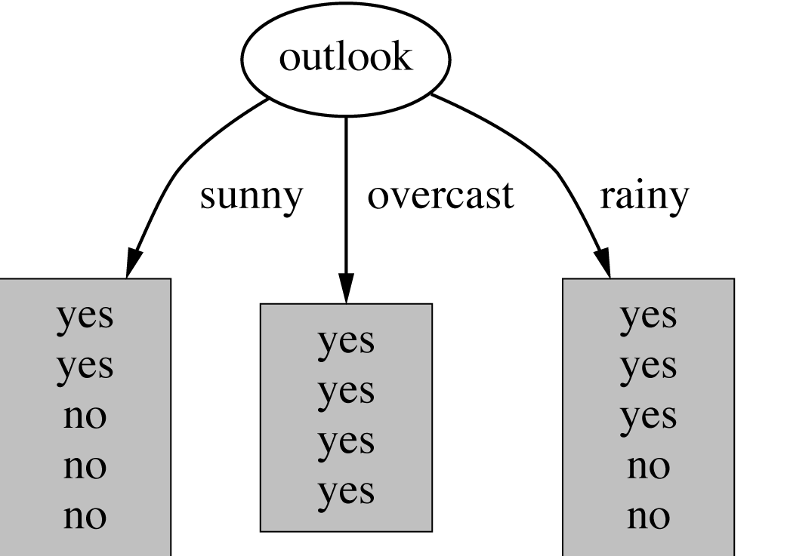
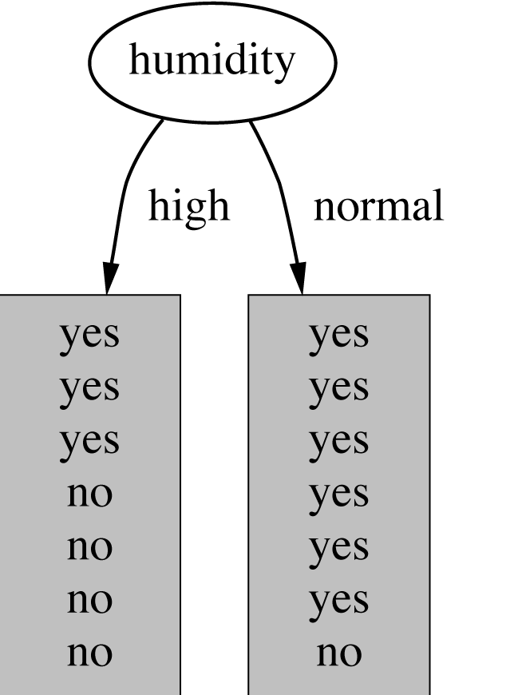
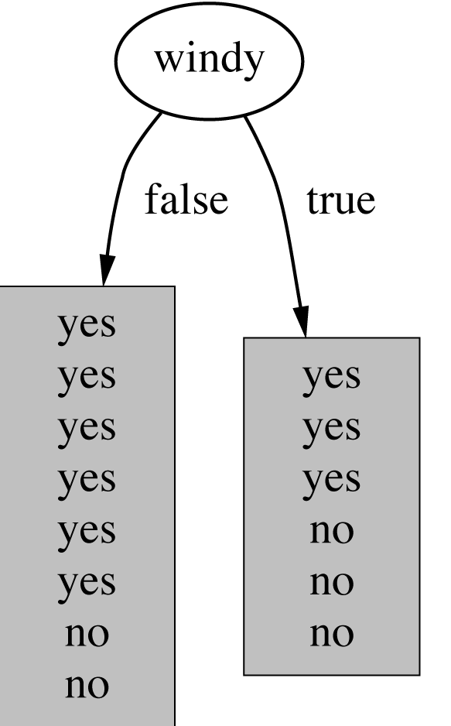
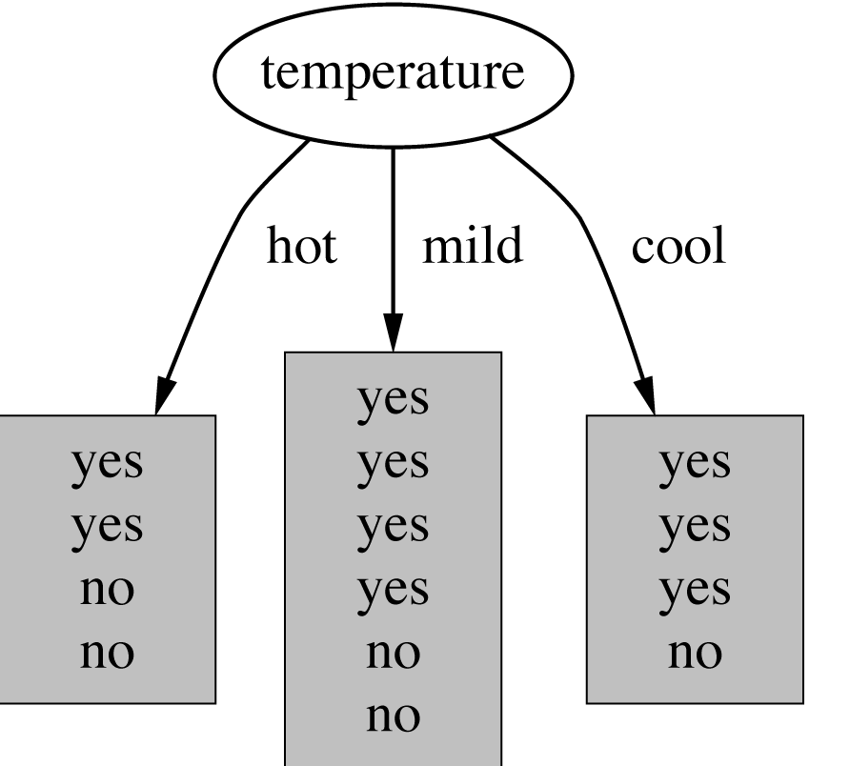
Which attribute to select?
Notes:
Can you calculate information for each leaf of each attribute?

Slide 29
Example: attribute “Outlook”
“Outlook” = “Sunny”:
“Outlook” = “Overcast”:
“Outlook” = “Rainy”:
Expected information for attribute:
Note: this is
normally not
defined.

Slide 30
Computing the information gain
Information gain: information before splitting – information after splitting
Information gain for attributes from weather data:

Slide 31
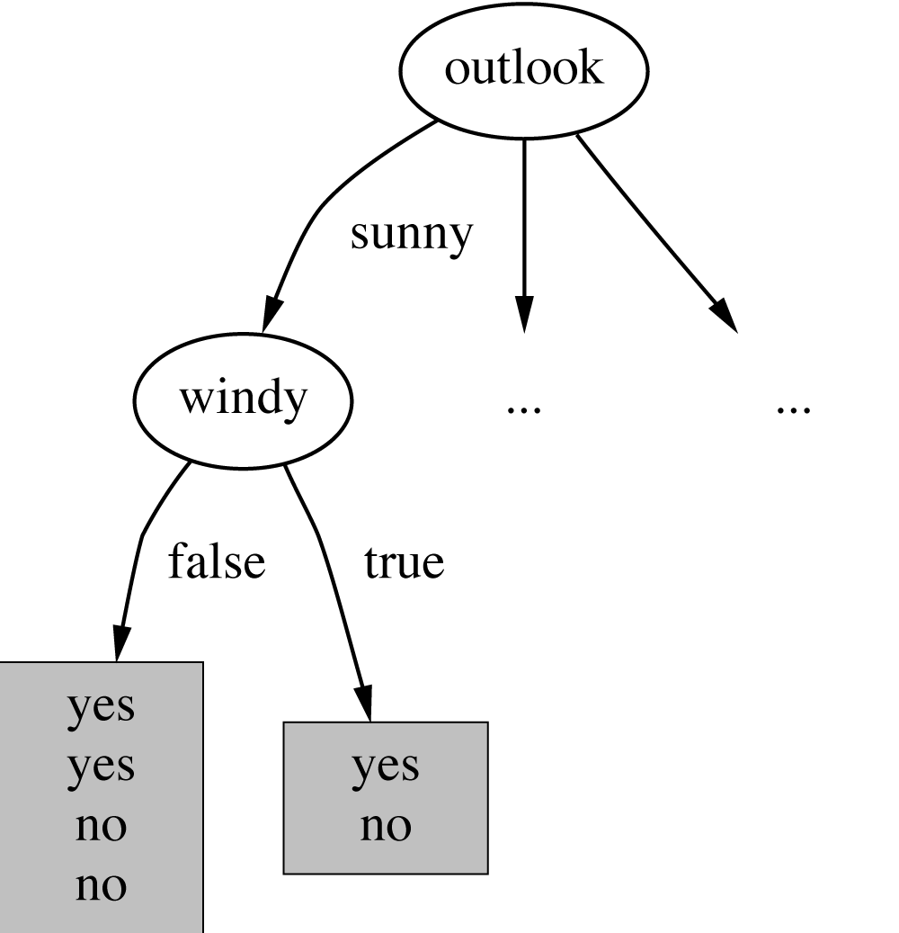
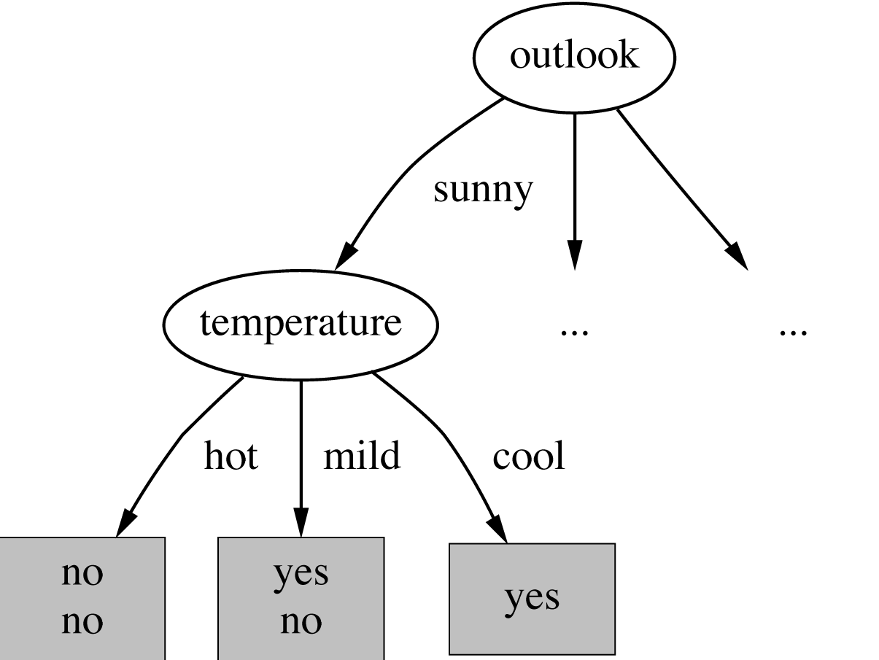
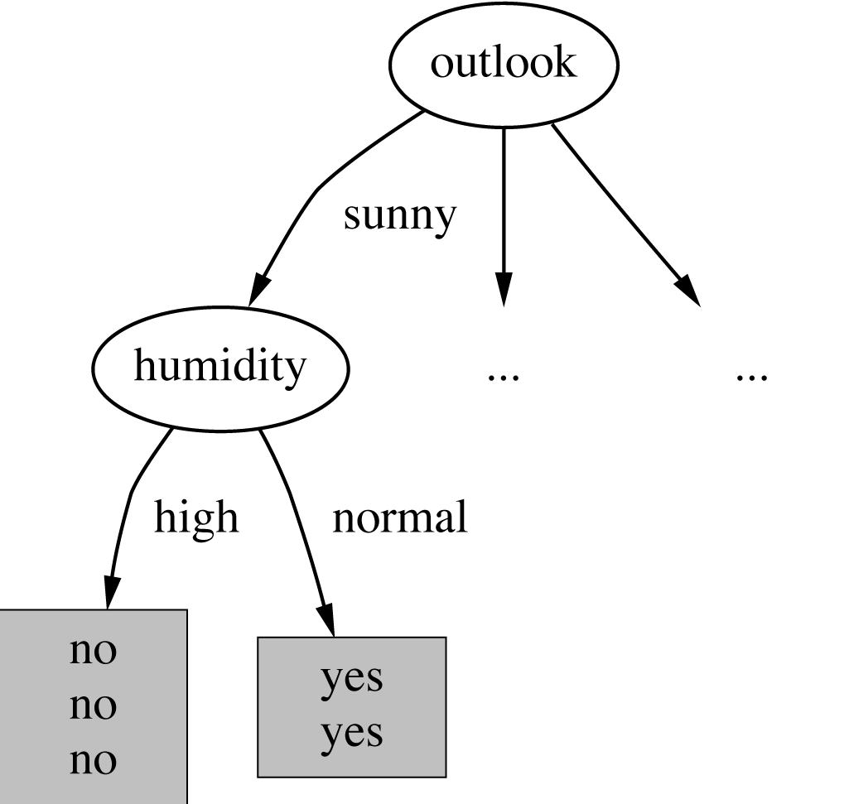
Continuing to split
Notes:
Again can you calculate the new information for each leaf? How do you calculate the information gain?

Slide 32
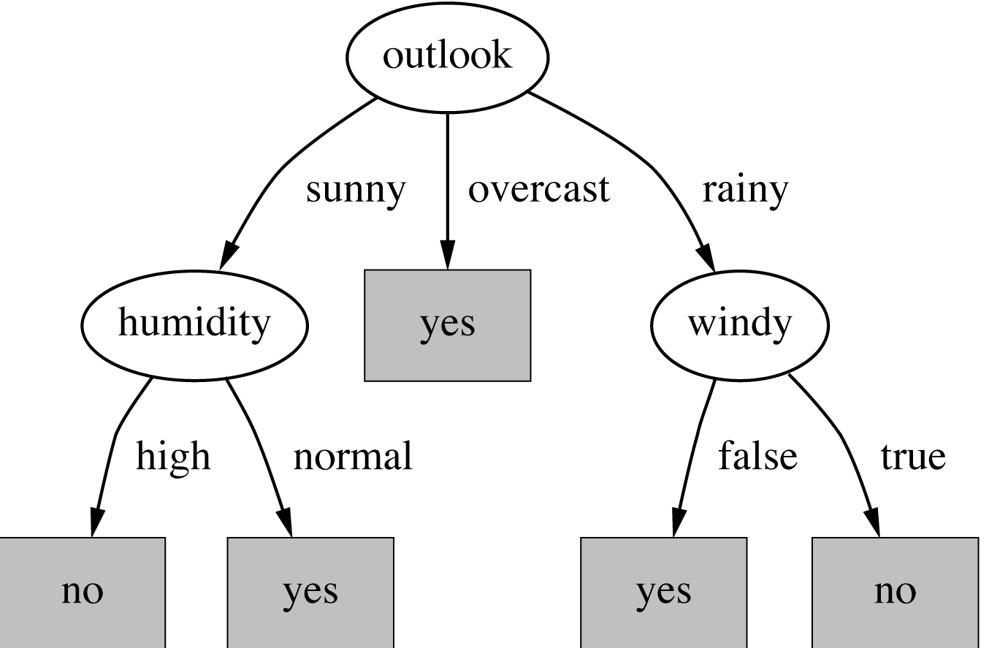
The final decision tree
Note: not all leaves need to be pure; sometimes identical instances have different classes
⇒ Splitting stops when nodes are pure and/or data can’t be split any further
Notes:
How do we know if all instances are covered?

Slide 33
The weather data with ID code
ID code | Outlook | Temp. | Humidity | Windy | Play
A | Sunny | Hot | High | False | No
B | Sunny | Hot | High | True | No
C | Overcast | Hot | High | False | Yes
D | Rainy | Mild | High | False | Yes
E | Rainy | Cool | Normal | False | Yes
F | Rainy | Cool | Normal | True | No
G | Overcast | Cool | Normal | True | Yes
H | Sunny | Mild | High | False | No
I | Sunny | Cool | Normal | False | Yes
J | Rainy | Mild | Normal | False | Yes
K | Sunny | Mild | Normal | True | Yes
L | Overcast | Mild | High | True | Yes
M | Overcast | Hot | Normal | False | Yes
N | Rainy | Mild | High | True | No

Slide 34
Wish list for an ambiguity measure
Properties desired for an ambiguity measure:
When node is pure, measure should be zero
Completely unambiguous!
When ambiguity is maximal (i.e., all classes equally likely), measure should be maximal
Measure should obey multistage property (i.e., decisions can be made in several stages):
Entropy is the only function that satisfies all three properties!

Slide 35
Multistage property
The multistage property:
Simplification of computation:
Note: instead of maximizing info gain we could just minimize information
Notes:
(p+q+r=1)

Slide 36
Highly-branching attributes
Problematic: attributes with a large number of values (extreme case: ID code)
Subsets are more likely to be pure if there is a large number of values
Information gain is biased towards choosing attributes with a large number of values
This may result in overfitting (selection of an attribute that is non-optimal for prediction)
Related problem: fragmentation of training set
Notes:
Fragmentation occurs as a result of continuous partitioning of the instance space, which progressively lessens the statistical support of every partial (i.e., disjunctive) hypothesis. This is a natural result of applying a ‘divide and conquer’ approach, but is especially problematic when an attribute has a large number of values simply because few instances will be routed down any particular path.

Slide 37
The weather data with ID code
ID code | Outlook | Temp. | Humidity | Windy | Play
A | Sunny | Hot | High | False | No
B | Sunny | Hot | High | True | No
C | Overcast | Hot | High | False | Yes
D | Rainy | Mild | High | False | Yes
E | Rainy | Cool | Normal | False | Yes
F | Rainy | Cool | Normal | True | No
G | Overcast | Cool | Normal | True | Yes
H | Sunny | Mild | High | False | No
I | Sunny | Cool | Normal | False | Yes
J | Rainy | Mild | Normal | False | Yes
K | Sunny | Mild | Normal | True | Yes
L | Overcast | Mild | High | True | Yes
M | Overcast | Hot | Normal | False | Yes
N | Rainy | Mild | High | True | No

Slide 38
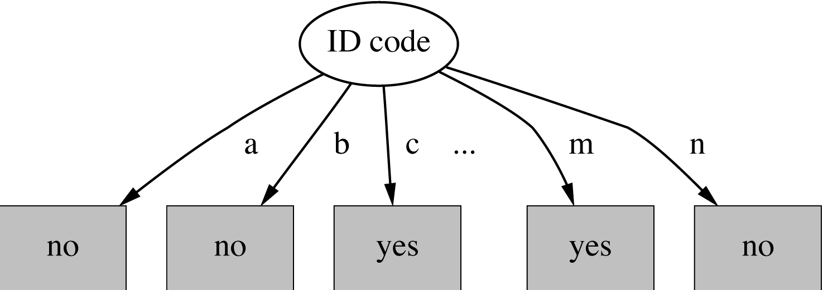
Tree stump for ID code attribute
Entropy of nodes:
Information gain is maximal for ID code (namely 0.940 bits)
Notes:
This is an example of fragmentation

Slide 39
The gain ratio
Gain ratio: a modification of the information gain that reduces its bias
Gain ratio takes number and size of branches into account when choosing an attribute
It corrects the information gain by taking the intrinsic information of a split into account
Intrinsic information: entropy of distribution of instances into branches (i.e., how much info do we need to tell which branch an instance belongs to)

Slide 40
Computing the gain ratio
Example: intrinsic information for ID code
Utility of attribute decreases as intrinsic information gets larger
Definition of gain ratio:
Example:

Slide 41
Gain ratios for weather data
Outlook |  | Temperature
Info: | 0.693 | Info: | 0.911
Gain: 0.940-0.693 | 0.247 | Gain: 0.940-0.911 | 0.029
Split info: info([5,4,5]) | 1.577 | Split info: info([4,6,4]) | 1.362
Gain ratio: 0.247/1.577 | 0.156 | Gain ratio: 0.029/1.362 | 0.021
Humidity |  | Windy
Info: | 0.788 | Info: | 0.892
Gain: 0.940-0.788 | 0.152 | Gain: 0.940-0.892 | 0.048
Split info: info([7,7]) | 1.000 | Split info: info([8,6]) | 0.985
Gain ratio: 0.152/1 | 0.152 | Gain ratio: 0.048/0.985 | 0.049

Slide 42
More on the gain ratio
“Outlook” still comes out top
However: “ID code” has greater gain ratio
Standard fix: ad hoc test to prevent splitting on that type of attribute
Problem with gain ratio: it may overcompensate
May choose an attribute just because its intrinsic information is very low (e.g., small numerator divided by small denominator)
Standard fix: only consider attributes with greater than average information gain

Slide 43
Discussion
Algorithm for top-down induction of decision trees (“ID3”) was developed by Ross Quinlan
Gain ratio just one modification of this basic algorithm
Led to development of C4.5, which can deal with numeric attributes, missing values, and noisy data
Similar approach: CART
There are many other attribute selection criteria! (But almost no difference in accuracy of result.)
Notes:
ID3 is a scheme described using information gain criterion. ID3 stands for Iterative Dichotomiser 3, created by Ross Quinlan in 1979.
C4.5 is a series of improvements to ID3. Called C4.5 because it is written in C and is version 4.5.
CART is an alternative to C4.5 and is a pruning strategy for learning classification and regression tree (CART stands for Classification And Regression Tree and was first introduced by Breiman, Freidman, Olshen, and Stone in 1984).

Slide 44
Covering algorithms
Decision tree can be converted into a rule set
Straightforward conversion: rule set overly complex
More effective conversions are not trivial
Strategy for generating a rule set directly: for each class in turn find rule set that covers all instances in it (excluding instances not in the class)
This approach is called a covering approach because at each stage a rule is identified that covers some of the instances
Notes:
Remember our examples from before (buying a car, a police officer giving tickets)

Slide 45
Example: generating a rule
If true then class = a
If x > 1.2 and y > 2.6 then class = a
If x > 1.2 then class = a
Possible rule set for class “b”:
More rules could be added for “perfect” rule set
If x ≤ 1.2 then class = b If x > 1.2 and y ≤ 2.6 then class = b
Notes:
What are the various values for TP-rate/recall, FP-rate, precision and F-measure for each of the three rules covering class A? Class B?
What rule would you add to the last picture to get a "perfect" rule set?
Can you come up with a new example similar to above but with 3 classes (A, B, and C)? What are the new values of recall, FP rate, precision, f- measure for each class? What are the new rules for your example?

Slide 46
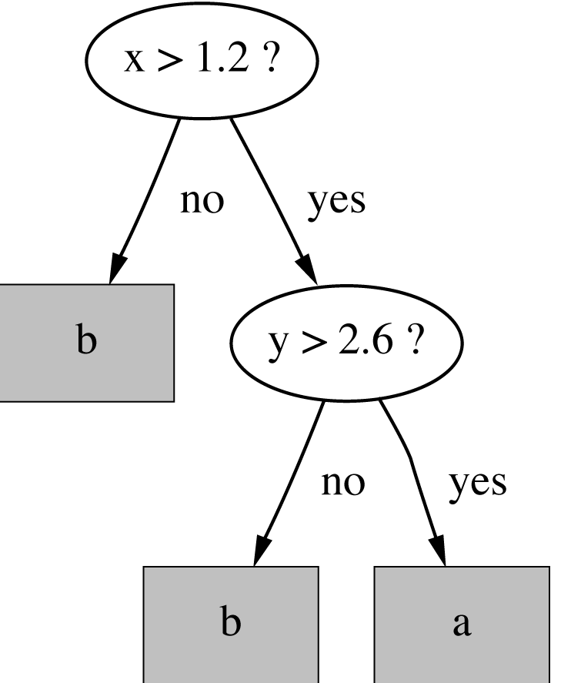
Rules vs. trees
Corresponding decision tree:
(produces exactly the same
predictions)
But: rule sets can be more perspicuous when decision trees suffer from replicated subtrees
Also: in multiclass situations, a covering algorithm concentrates on one class at a time whereas a decision tree learner takes all classes into account
Notes:
Perspicuous: plain to the understanding especially because of clarity and precision of presentation.

Slide 47
A simple covering algorithm
Generates a rule by adding tests that maximize rule’s accuracy
Similar to situation in decision trees, we have the problem of selecting an attribute to split on
But: decision tree inducer maximizes purity across all classes present in node
Each new term (test) in the
antecedent reduces the rule’s
coverage for class covered:
Notes:
Note that when a term is added to the antecedent, we hope to reduce FPs but may also reduce TPs.

Slide 48
Selecting a test
Goal: maximizing accuracy
t: total number of instances covered by rule
p: positive examples of the class covered by rule
t-p: number of errors made by rule
Select test that maximizes the ratio p/t
We are finished when p/t = 1 or the set of instances can’t be split any further
Notes:
Any recognize p/t? ☺ Sure enough, it’s your old friend precision in another guise. What is a possible problem with using p/t as the metric to maximize?

Slide 49
Example: contact lenses data
Rule we seek:
Possible tests:
If ? then recommendation = hard
Age = Young | 2/8
Age = Pre-presbyopic | 1/8
Age = Presbyopic | 1/8
Spectacle prescription = Myope | 3/12
Spectacle prescription = Hypermetrope | 1/12
Astigmatism = no | 0/12
Astigmatism = yes | 4/12
Tear production rate = Reduced | 0/12
Tear production rate = Normal | 4/12
Notes:
Contact lens data is from v3 of the book on page 6

Slide 50
Modified rule and resulting data
Rule with best test added:
Instances covered by modified rule:
If astigmatism = yes then recommendation = hard
Age | Spectacle prescription | Astigmatism | Tear production rate | Recommended lenses
Young | Myope | Yes | Reduced | None
Young | Myope | Yes | Normal | Hard
Young | Hypermetrope | Yes | Reduced | None
Young | Hypermetrope | Yes | Normal | Hard
Pre-presbyopic | Myope | Yes | Reduced | None
Pre-presbyopic | Myope | Yes | Normal | Hard
Pre-presbyopic | Hypermetrope | Yes | Reduced | None
Pre-presbyopic | Hypermetrope | Yes | Normal | None
Presbyopic | Myope | Yes | Reduced | None
Presbyopic | Myope | Yes | Normal | Hard
Presbyopic | Hypermetrope | Yes | Reduced | None
Presbyopic | Hypermetrope | Yes | Normal | None

Slide 51
Further refinement
If astigmatism = yes and ? then recommendation = hard
Current state:
Possible tests:
Age = Young | 2/4
Age = Pre-presbyopic | 1/4
Age = Presbyopic | 1/4
Spectacle prescription = Myope | 3/6
Spectacle prescription = Hypermetrope | 1/6
Tear production rate = Reduced | 0/6
Tear production rate = Normal | 4/6

Slide 52
Modified rule and resulting data
Rule with best test added:
Instances covered by modified rule:
If astigmatism = yes and tear production rate = normal then recommendation = hard
Age | Spectacle prescription | Astigmatism | Tear production rate | Recommended lenses
Young | Myope | Yes | Normal | Hard
Young | Hypermetrope | Yes | Normal | Hard
Pre-presbyopic | Myope | Yes | Normal | Hard
Pre-presbyopic | Hypermetrope | Yes | Normal | None
Presbyopic | Myope | Yes | Normal | Hard
Presbyopic | Hypermetrope | Yes | Normal | None

Slide 53
Further refinement
If astigmatism = yes and tear production rate = normal and ? then recommendation = hard
Current state:
Possible tests:
Tie between the first and the fourth test
We choose the one with greater coverage
Age = Young | 2/2
Age = Pre-presbyopic | 1/2
Age = Presbyopic | 1/2
Spectacle prescription = Myope | 3/3
Spectacle prescription = Hypermetrope | 1/3
Notes:
Something to think about: this ‘tie’ between age=young and prescription=myope reveals a deeper issue related to a bias of this algorithm. To understand the nature of the bias, think about the ratio p/t… naturally, we want p/t to reach its maximum of one (1). But what possible values of p and t achieve this? In the example above, 2/2 and 3/3 both achieve the maximum. How about 1/1? Interesting… 1/1 also achieves a maximum. But p/t does not distinguish between these different values of p and t. What do you think would be the result if a ruleset was generated for which p==t==1 in every case? I think you get the point now… what is the bias of this algorithm? It learns rules that maximize precision, but the use of precision biases the algorithm to find rules that cover a small number of instances, which may result in overfitting the data. Now, how could this be mitigated? How would you change the algorithm (on the slide after the next slide) to address this bias?

Slide 54
The result
If astigmatism = yes and tear production rate = normal and spectacle prescription = myope then recommendation = hard
Final rule:
Second rule for recommending “hard lenses”:
(built from instances not covered by first rule)
These two rules cover all “hard lenses”:
Process is repeated with other two classes
If age = young and astigmatism = yes and tear production rate = normal then recommendation = hard
Notes:
Can you come up with the rules for the other two classes (no lenses, soft lenses)?

Slide 55
Pseudo-code for PRISM
For each class C Initialize E to the instance set While E contains instances in class C Create a rule R with an empty left-hand side that predicts class C Until R is perfect (or there are no more attributes to use) do For each attribute A not mentioned in R, and each value v, Consider adding the condition A = v to the left-hand side of R Select A and v to maximize the accuracy p/t (break ties by choosing the condition with the largest p) Add A = v to R Remove the instances covered by R from E
Notes:
PRISM is a method for constructing rules, and only generates "perfect" rules. It uses the formula p/t, and if p/t<100% it is considered "incorrect." It was created by Cendrowska in 1987.

Slide 56
Rules vs. decision lists
PRISM with outer loop removed generates a decision list for one class
Subsequent rules are designed for instances that are not covered by previous rules
But: order doesn’t matter because all rules predict the same class
Outer loop considers all classes separately
No order dependence implied
Problems: overlapping rules, default rule required

Slide 57
Separate and conquer
Methods like PRISM (for dealing with one class) are separate-and-conquer algorithms:
First, a rule is identified
Then, all instances covered by the rule are separated out
Finally, the remaining instances are “conquered”
Difference with divide-and-conquer methods:
Instance set continually shrinks as rules are generated, thereby improving efficiency (reducing run time)

Slide 58
Mining association rules
Naïve method for finding association rules:
Using the standard separate-and-conquer method, treating every possible combination of attribute values as a separate class
Two problems:
Computational complexity
Resulting number of rules (which would have to be pruned on the basis of support and confidence)
But: we can look for high support rules directly!
Notes:
What is it that makes the straightforward separate-and-conquer approach to ARM computationally complex? Consider the weather data… it has 12 attribute-value pairs. How many combinations are there?
Stop here for Lecture 5

Slide 59
Item sets
Support: number of instances (or transactions) correctly covered by association rule
The same as the number of instances covered by all tests in the rule (LHS and RHS!)
Item: one test/attribute-value pair
Item set: all items occurring in a rule
Goal: only rules that exceed pre-defined support
⇒ We can do it by finding all item sets with the given minimum support and generating rules from them!

Slide 60
Item sets for weather data
One-item sets | Two-item sets | Three-item sets | Four-item sets
Outlook = Sunny (5) | Outlook = Sunny Temperature = Mild (2) | Outlook = Sunny Temperature = Hot Humidity = High (2) | Outlook = Sunny Temperature = Hot Humidity = High Play = No (2)
Temperature = Cool (4) | Outlook = Sunny Humidity = High (3) | Outlook = Sunny Humidity = High Windy = False (2) | Outlook = Rainy Temperature = Mild Windy = False Play = Yes (2)
… | … | … | …
In total: 12 one-item sets, 47 two-item sets, 39 three-item sets, 6 four-item sets and 0 five-item sets (with minimum support of two)

Slide 61
Generating rules from an item set
Once all item sets with minimum support have been generated, we can turn them into rules
Example:
Seven (2^{N}-1) potential rules:
Humidity = Normal, Windy = False, Play = Yes (4)
If Humidity = Normal and Windy = False then Play = Yes If Humidity = Normal and Play = Yes then Windy = False If Windy = False and Play = Yes then Humidity = Normal If Humidity = Normal then Windy = False and Play = Yes If Windy = False then Humidity = Normal and Play = Yes If Play = Yes then Humidity = Normal and Windy = False If True then Humidity = Normal and Windy = False and Play = Yes (Note: there is a typo in the 2nd edition of the textbook on page 115 – it says 4/12.) | 4/4 4/6 4/6 4/7 4/8 4/9 4/14
Notes:
Another way to count the total number of rules is to think about the number of ways the antecedent can be chosen. If we sum up all the ways, we get 3 choose 0 = 1 (the ‘if true’ antecedent), plus 3 choose 1 = 3 (the ‘if play’, ‘if windy’ and ‘if humidity’ antecedents), plus 3 choose 2 = 3 (the first three antecedents in the first three potential rules above), which equals 7. We do not consider 3 choose 3 because we cannot have an empty consequent in a rule. For a given item set with n items in it, the sum of n choose i for i=0,n-1 is 2^n – 1.

Slide 62
Rules for the weather data
Rules with support > 1 and confidence = 100%:
In total: 3 rules with support four, 5 with support three, and 50 with support two
 | Association rule |  | Sup. | Conf
1 | Humidity=Normal Windy=False | ⇒Play=Yes | 4 | 100%
2 | Temperature=Cool | ⇒Humidity=Normal | 4 | 100%
3 | Outlook=Overcast | ⇒Play=Yes | 4 | 100%
4 | Temperature=Cold Play=Yes | ⇒Humidity=Normal | 3 | 100%
... | ... | ... | ... | ...
58 | Outlook=Sunny Temperature=Hot | ⇒Humidity=High | 2 | 100%
Notes:
Association rule mining uses the same metric as PRISM – TP/(TP+FP), or precision. In the last lecture, we saw a potential pitfall when we used precision in PRISM – does this same potential pitfall exist when using precision to discover rules in association rule mining? Why or why not?

Slide 63
Example rules from the same set
Item set:
Resulting rules all with 100% confidence:
due to the following “frequent” item sets:
Temperature = Cool, Humidity = Normal, Windy = False, Play = Yes (2)
Temperature = Cool, Windy = False ⇒ Humidity = Normal, Play = Yes Temperature = Cool, Windy = False, Humidity = Normal ⇒ Play = Yes Temperature = Cool, Windy = False, Play = Yes ⇒ Humidity = Normal
Temperature = Cool, Windy = False (2) Temperature = Cool, Humidity = Normal, Windy = False (2) Temperature = Cool, Windy = False, Play = Yes (2)
Notes:
Notice that the antecedents of all three rules occur in itemsets of frequency equal to the frequency of the itemset used to generate the rule. (In the case above, frequency 2.) This is why confidence is 100%. Actually, this gives a clue as to how we can generate both itemsets and rules more efficiently.

Slide 64
Generating item sets efficiently
How can we efficiently find all frequent item sets?
Finding one-item sets easy
Idea: use one-item sets to generate two-item sets, two-item sets to generate three-item sets, …
If (A B) is a frequent item set, then (A) and (B) have to be frequent item sets as well!
In general: if X is frequent k-item set, then all (k-1)-item subsets of X are also frequent
⇒ Compute k-item set by merging (k-1)-item sets

Slide 65
An example
Given: five three-item sets
(A B C), (A B D), (A C D), (A C E), (B C D)
Lexicographically ordered and stored in hash table
Candidate four-item sets:
(A B C D) OK: (A C D) & (B C D) exist in hash
(A C D E) not OK: (A D E) & (C D E) missing!
Final check for minimum coverage can be done only by counting instances in dataset
(k)-item sets not pruned are stored in hash table

Slide 66
Generating rules efficiently
We are looking for all high-confidence rules
Support of antecedent obtained from hash table
But: brute-force method is (2^{N}-1)
Better way: building (c + 1)-consequent rules from c-consequent ones
Observation: (c + 1)-consequent rule can only hold if all corresponding c-consequent rules also hold
Resulting algorithm similar to procedure for large item sets

Slide 67
Example
1-consequent rules:
Corresponding 2-consequent rule:
Final test of rule must be done by checking support of antecedent in the hash table to confirm that rule has minimum accuracy
If Outlook = Sunny and Windy = False and Play = No then Humidity = High (2/2)
If Humidity = High and Windy = False and Play = No then Outlook = Sunny (2/2)
If Windy = False and Play = No then Outlook = Sunny and Humidity = High (2/2)

Slide 68
Discussion of association rules
Above method makes one pass through the data for each different size item set
Other possibility: generate (k+2)-item sets just after (k+1)-item sets have been generated
Result: more (k+2)-item sets than necessary will be considered but less passes through the data
Makes sense if data too large for main memory
Practical issue: generating a certain number of rules (e.g., by incrementally reducing min support)

Slide 69
Other issues
ARFF format very inefficient for typical market basket data
Attributes represent items in a basket and most items are usually missing
Same issue arises in co-occurrence analysis in document collections
Confidence is not necessarily the best measure
Example: milk occurs in almost every supermarket transaction. What impact could this have?
Other measures have been devised (e.g., lift)
Notes:
If milk occurs with almost every purchase, that means that an antecedent with just milk in it will have a large support in the transaction database. If we have a rule like “if milk then eggs”, the number of true positives (milk and eggs purchased together) may be quite high, but since milk occurs in almost every transaction, the number of false positives (milk and anything other than eggs purchased together) will be even higher, and the confidence (precision = TP/(TP+FP)) may be relatively low. As was the case with PRISM, the use of precision as a scoring metric introduces certain biases.

Slide 70
Linear models: linear regression
Work most naturally with numeric attributes
Standard technique for numeric prediction
Outcome is linear combination of attributes
Weights are calculated from the training data
Predicted value for first training instance a⁽¹⁾ (assuming each instance is extended with a constant attribute with value 1)

Slide 71
Minimizing the squared error
Choose k +1 coefficients to minimize the squared error on the training data
Squared error:
Derive coefficients using standard matrix operations
Can be done if there are more instances than attributes (roughly speaking)
Minimizing the absolute error is more difficult

Slide 72
Classification
Any regression technique can be used for classification
Training: perform a regression for each class, setting the output to 1 for training instances that belong to class, and 0 for those that don’t
Prediction: predict class corresponding to model with largest output value (membership value)
For linear regression this is known as multi-response linear regression
Problem: membership values are not in [0,1] range, so aren't proper probability estimates

Slide 73
Linear models: logistic regression
Builds a linear model for a transformed target variable
Assume we have two classes
Logistic regression replaces the target
by this target
Logit transformation maps [0,1] to (-∞ , +∞ )
Notes:
Fix equation

Slide 74
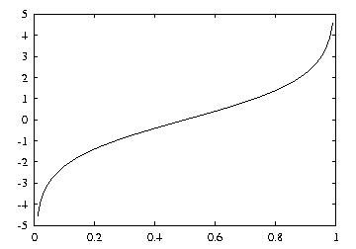
Logit transformation
Resulting model:
Notes:
Fix equation

Slide 75
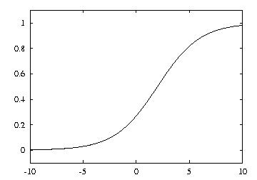
Example logistic regression model
Model with w₀ = 0.5 and w₁ = 1:
Parameters are found from training data using maximum likelihood

Slide 76
Maximum likelihood
Aim: maximize probability of training data wrt parameters
Can use logarithms of probabilities and maximize log-likelihood of model: where the x^{(i)} are either 0 or 1
Weights w_{i} need to be chosen to maximize log-likelihood (relatively simple method: iteratively re-weighted least squares)
Notes:
Fix equation

Slide 77
Multiple classes
Can perform logistic regression independently for each class (like multi-response linear regression)
Problem: probability estimates for different classes won't sum to one
Better: train coupled models by maximizing likelihood over all classes
Alternative that often works well in practice: pairwise classification

Slide 78
Pairwise classification
Idea: build model for each pair of classes, using only training data from those classes
Problem? Have to solve k(k-1)/2 classification problems for k-class problem
Turns out not to be a problem in many cases because training sets become small:
Assume data evenly distributed, i.e. 2n/k per learning problem for n instances in total
Suppose learning algorithm is linear in n
Then runtime of pairwise classification is proportional to (k(k-1)/2)×(2n/k) = (k-1)n

Slide 79
Linear models are hyperplanes
Decision boundary for two-class logistic regression is where probability equals 0.5:
which occurs when
Thus logistic regression can only separate data that can be separated by a hyperplane
Multi-response linear regression has the same problem. Class 1 is assigned if:
Notes:
Fix equation

Slide 80
Linear models: the perceptron
Don't actually need probability estimates if all we want to do is classification
Different approach: learn separating hyperplane
Assumption: data is linearly separable
Algorithm for learning separating hyperplane: perceptron learning rule
Hyperplane: where we again assume that there is a constant attribute with value 1 (bias)
If sum is greater than zero we predict the first class, otherwise the second class

Slide 81
The algorithm
Set all weights to zero
Until all instances in the training data are classified correctly
For each instance I in the training data
If I is classified incorrectly by the perceptron
If I belongs to the first class add it to the weight vector
else subtract it from the weight vector
Why does this work? Consider situation where instance a pertaining to the first class has been added:
This means output for a has increased by:
This number is always positive, thus the hyperplane has moved into the correct direction (and we can show output decreases for instances of other class)

Slide 82
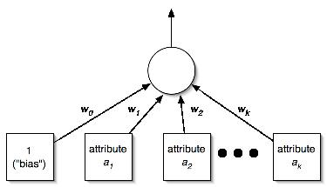
Perceptron as a neural network
Output
layer
Input
layer

Slide 83
Linear models: Winnow
Another mistake-driven algorithm for finding a separating hyperplane
Assumes binary data (i.e. attribute values are either zero or one)
Difference: multiplicative updates instead of additive updates
Weights are multiplied by a user-specified parameter α > 1 (or its inverse)
Another difference: user-specified threshold parameter θ
Predict first class if

Slide 84
The algorithm
while some instances are misclassified
for each instance a in the training data
classify a using the current weights
if the predicted class is incorrect
if a belongs to the first class
for each a_{i} that is 1, multiply w_{i} by alpha
(if a_{i} is 0, leave w_{i} unchanged)
otherwise
for each a_{i} that is 1, divide w_{i} by alpha
(if a_{i} is 0, leave w_{i} unchanged)
Winnow is very effective in homing in on relevant features (it is attribute efficient)
Can also be used in an on-line setting in which new instances arrive continuously (like the perceptron algorithm)

Slide 85
Balanced Winnow
Winnow doesn't allow negative weights and this can be a drawback in some applications
Balanced Winnow maintains two weight vectors, one for each class:
Instance is classified as belonging to the first class (of two classes) if:
while some instances are misclassified
for each instance a in the training data
classify a using the current weights
if the predicted class is incorrect
if a belongs to the first class
for each a_{i} that is 1, multiply w_{i}⁺ by alpha and divide w_{i}⁻ by alpha
(if a_{i} is 0, leave w_{i}⁺ and w_{i}⁻ unchanged)
otherwise
for each a_{i} that is 1, multiply w_{i}⁻ by alpha and divide w_{i}⁺ by alpha
(if a_{i} is 0, leave w_{i}⁺ and w_{i}⁻ unchanged)

Slide 86
Instance-based learning
Distance function defines what’s learned
Most instance-based schemes use Euclidean distance: a⁽¹⁾ and a⁽²⁾: two instances with k attributes
Taking the square root is not required when comparing distances
Other popular metric: city-block metric
Adds differences without squaring them

Slide 87
Normalization and other issues
Different attributes are measured on different scales ⇒ need to be normalized:
v_{i} : the actual value of attribute i
Nominal attributes: distance either 0 or 1
Common policy for missing values: assumed to be maximally distant (given normalized attributes)

Slide 88
Finding nearest neighbors efficiently
Simplest way of finding nearest neighbor: linear scan of the data
Classification takes time proportional to the product of the number of instances in training and test sets
Nearest-neighbor search can be done more efficiently using appropriate data structures
We will discuss two methods that represent training data in a tree structure: kD-trees and ball trees

Slide 89
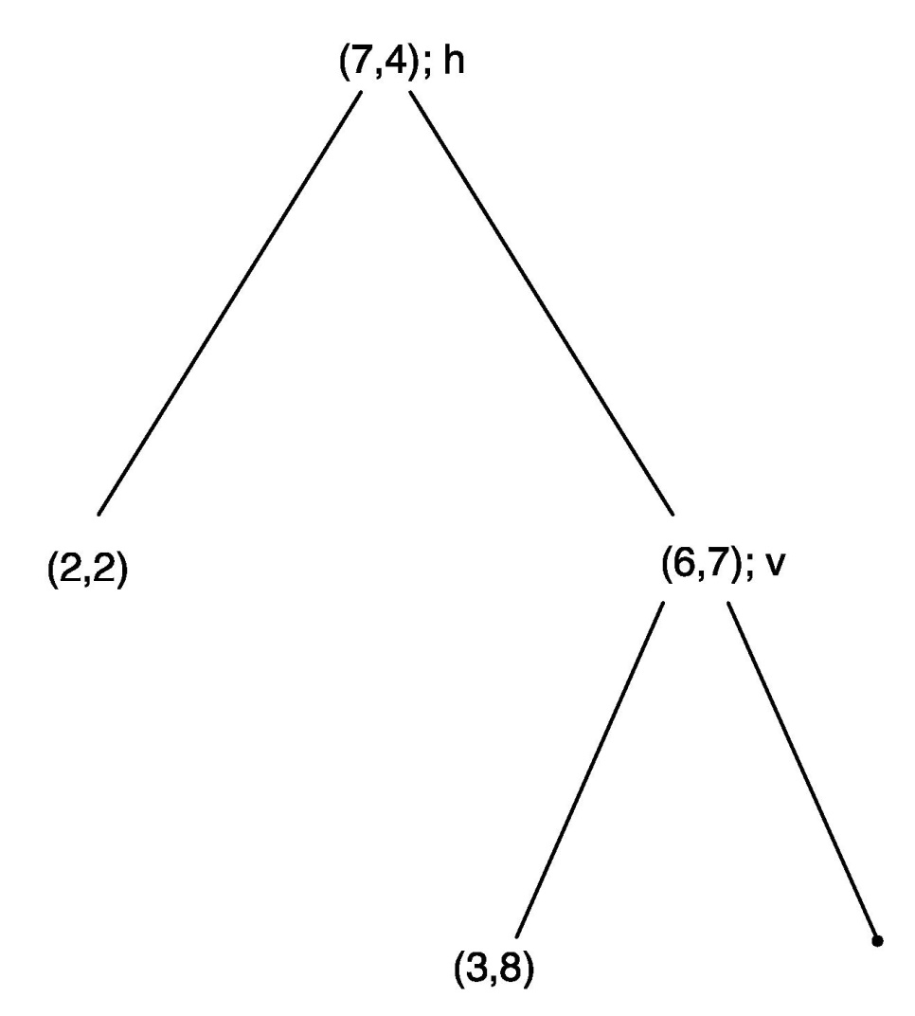
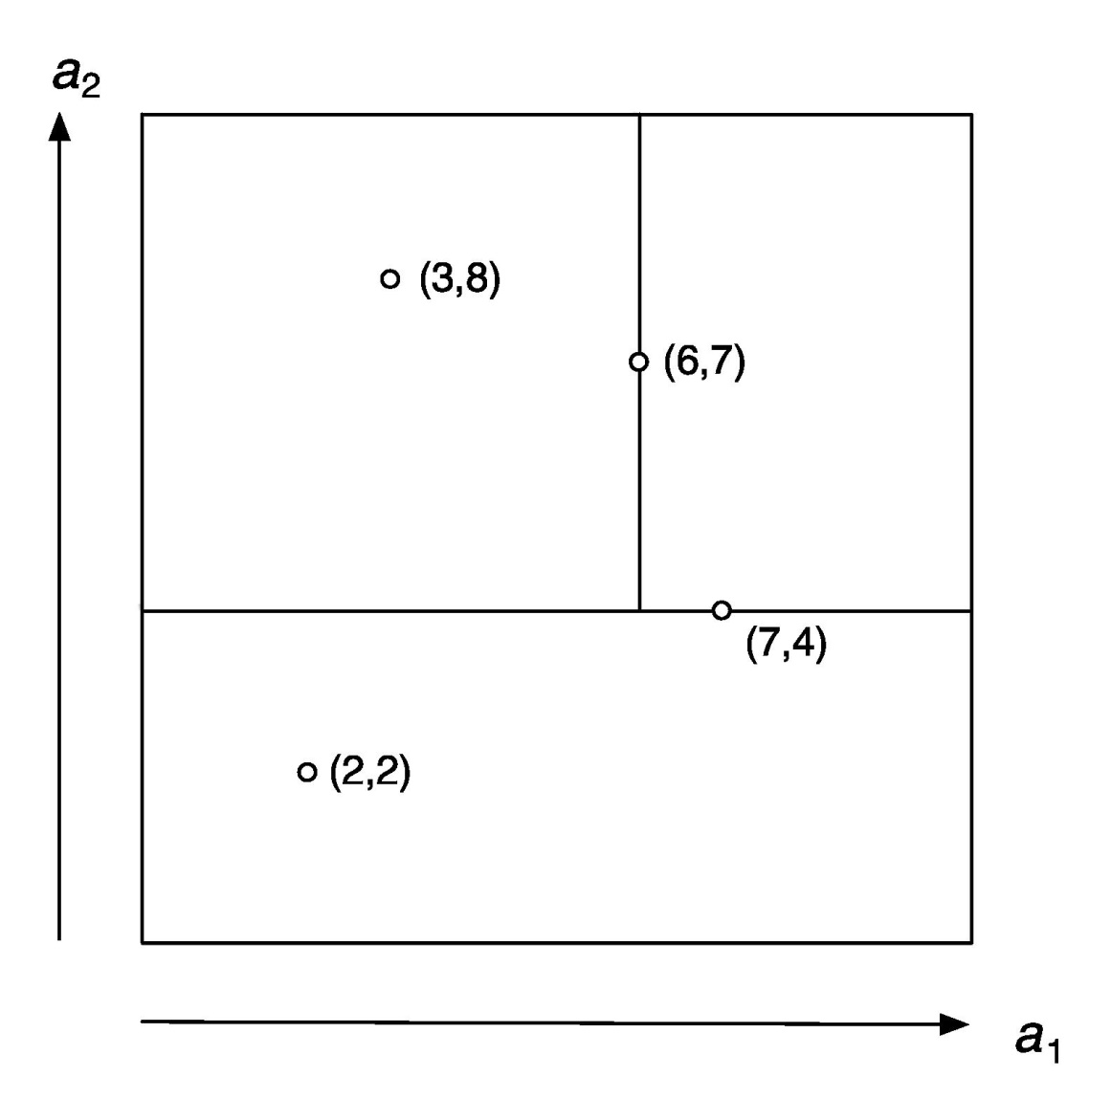
kD-tree example

Slide 90
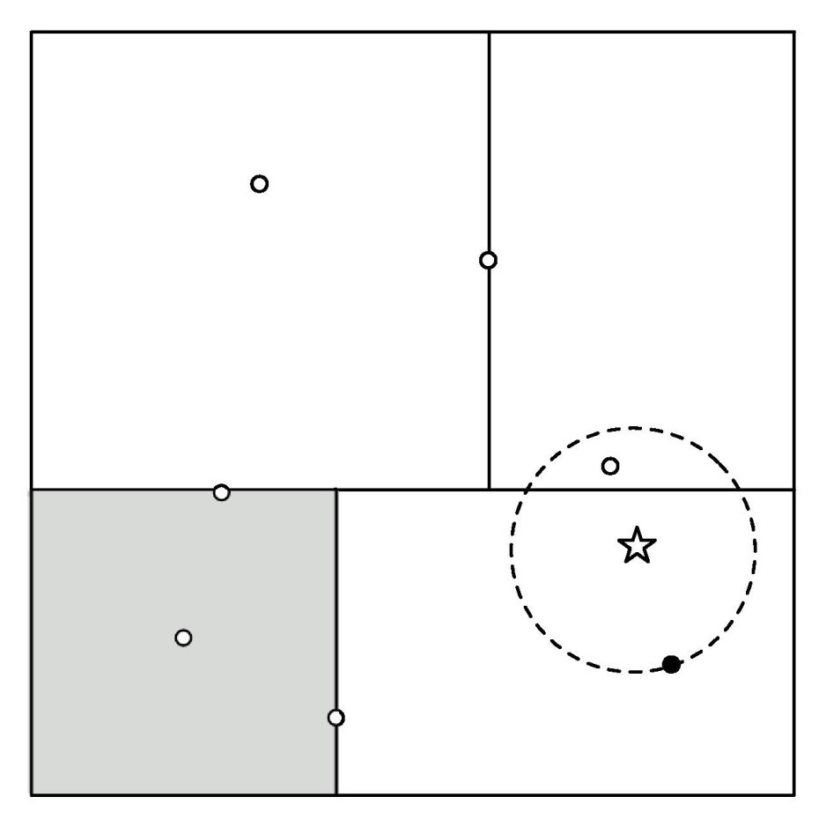
Using kD-trees: example

Slide 91
More on kD-trees
Complexity depends on depth of tree, given by logarithm of number of nodes
Amount of backtracking required depends on quality of tree (“square” vs. “skinny” nodes)
How to build a good tree? Need to find good split point and split direction
Split direction: direction with greatest variance
Split point: median value along that direction
Using value closest to mean (rather than median) can be better if data is skewed
Can apply this recursively

Slide 92
Building trees incrementally
Big advantage of instance-based learning: classifier can be updated incrementally
Just add new training instance!
Can we do the same with kD-trees?
Heuristic strategy:
Find leaf node containing new instance
Place instance into leaf if leaf is empty
Otherwise, split leaf according to the longest dimension (to preserve squareness)
Tree should be re-built occasionally (i.e. if depth grows to twice the optimum depth)

Slide 93
Ball trees
Problem in kD-trees: corners
Observation: no need to make sure that regions don't overlap
Can use balls (hyperspheres) instead of hyperrectangles
A ball tree organizes the data into a tree of k-dimensional hyperspheres
Normally allows for a better fit to the data and thus more efficient search

Slide 94
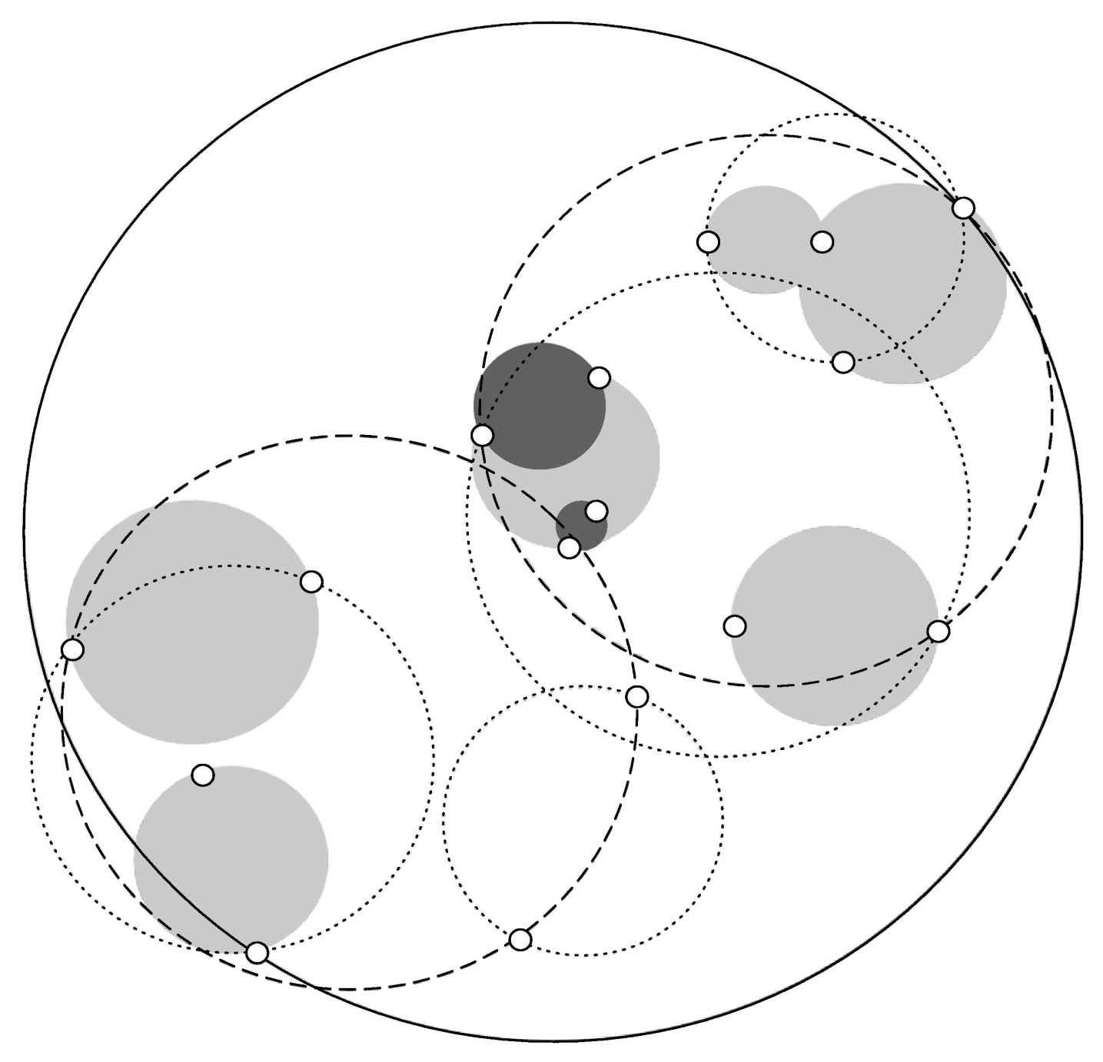
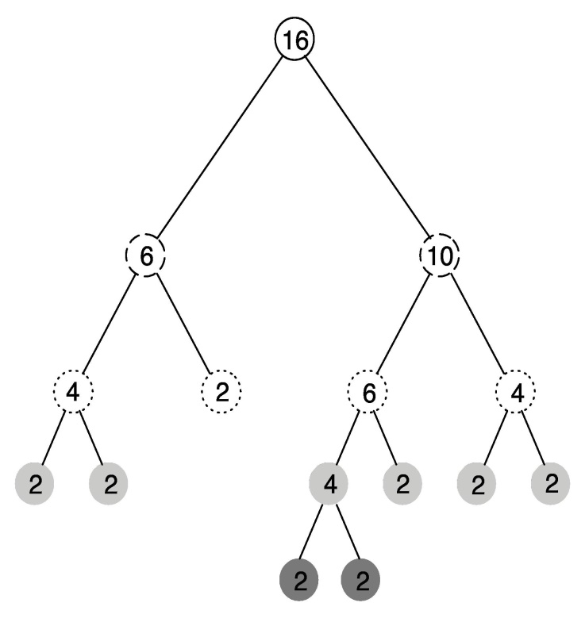
Ball tree example

Slide 95
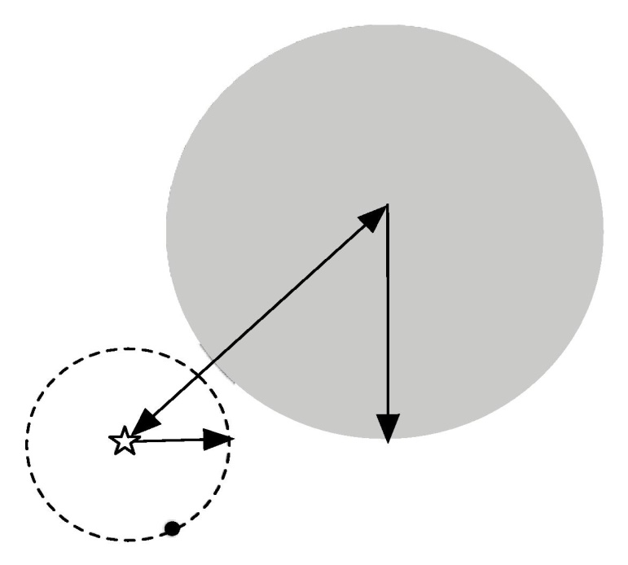
Using ball trees
Nearest-neighbor search is done using the same backtracking strategy as in kD-trees
Ball can be ruled out from consideration if: distance from target to ball's center exceeds ball's radius plus current upper bound

Slide 96
Building ball trees
Ball trees are built top down (like kD-trees)
Don't have to continue until leaf balls contain just two points: can enforce minimum occupancy (same in kD-trees)
Basic problem: splitting a ball into two
Simple (linear-time) split selection strategy:
Choose point farthest from ball's center
Choose second point farthest from first one
Assign each point to these two points
Compute cluster centers and radii based on the two subsets to get two balls

Slide 97
Discussion of nearest-neighbor learning
Often very accurate
Assumes all attributes are equally important
Remedy: attribute selection or weights
Possible remedies against noisy instances:
Take a majority vote over the k nearest neighbors
Removing noisy instances from dataset (difficult!)
Statisticians have used k-NN since early 1950s
kD-trees become inefficient when number of attributes is too large (approximately > 10)
Ball trees (which are instances of metric trees) work well in higher-dimensional spaces

Slide 98
More discussion
Instead of storing all training instances, compress them into regions
Example: hyperpipes (from discussion of 1R)
Another simple technique (Voting Feature Intervals):
Construct intervals for each attribute
Discretize numeric attributes
Treat each value of a nominal attribute as an “interval”
Count number of times class occurs in interval
Prediction is generated by letting intervals vote (those that contain the test instance)

Slide 99
Clustering
Clustering techniques apply when there is no class to be predicted
Aim: divide instances into “natural” groups
As we've seen clusters can be:
disjoint vs. overlapping
deterministic vs. probabilistic
flat vs. hierarchical
We'll look at a classic clustering algorithm called k-means
k-means clusters are disjoint, deterministic, and flat

Slide 100
The k-means algorithm
To cluster data into k groups: (k is predefined)
Choose k cluster centers (e.g. at random)
Assign instances to clusters (based on distance to cluster centers)
Compute centroids of clusters
Go to step 1 (until convergence)

Slide 101
Discussion
Algorithm minimizes squared distance to cluster centers
Result can vary significantly
based on initial choice of seeds
Can get trapped in local minimum
Example:
To increase chance of finding global optimum: restart with different random seeds
Can we applied recursively with k = 2
initial cluster centres
instances

Slide 102
Faster distance calculations
Can we use kD-trees or ball trees to speed up the process? Yes:
First, build tree, which remains static, for all the data points
At each node, store number of instances and sum of all instances
In each iteration, descend tree and find out which cluster each node belongs to
Can stop descending as soon as we find out that a node belongs entirely to a particular cluster
Use statistics stored at the nodes to compute new cluster centers

Slide 103
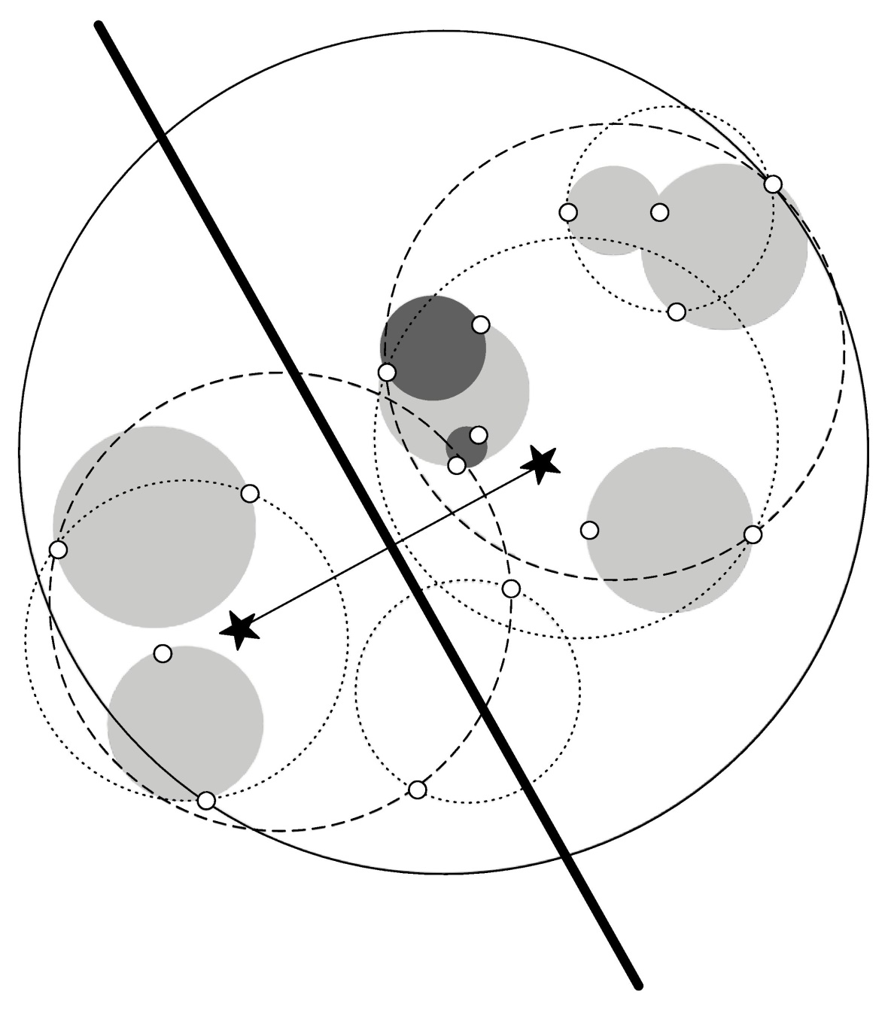
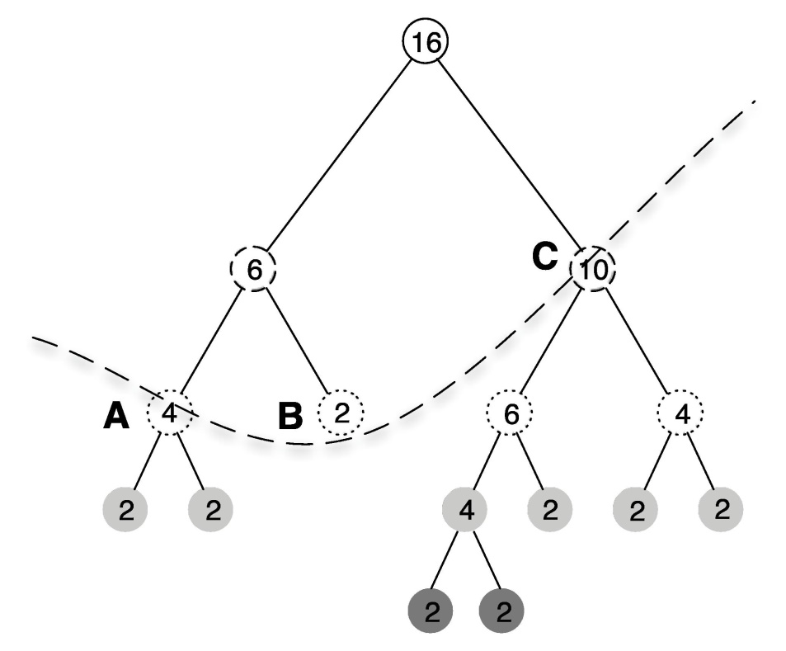
Example

Slide 104
Multi-instance learning
Simplicity-first methodology can be applied to multi-instance learning with surprisingly good results
Two simple approaches, both using standard single-instance learners:
Manipulate the input to learning
Manipulate the output of learning

Slide 105
Aggregating the input
Convert multi-instance problem into single-instance one
Summarize the instances in a bag by computing mean, mode, minimum and maximum as new attributes
“Summary” instance retains the class label of its bag
To classify a new bag the same process is used
Results using summary instances with minimum and maximum + support vector machine classifier are comparable to special purpose multi-instance learners on original drug discovery problem

Slide 106
Aggregating the output
Learn a single-instance classifier directly from the original instances in each bag
Each instance is given the class of the bag it originates from
To classify a new bag:
Produce a prediction for each instance in the bag
Aggregate the predictions to produce a prediction for the bag as a whole
One approach: treat predictions as votes for the various class labels
A problem: bags can contain differing numbers of instances → give each instance a weight inversely proportional to the bag's size

